Slide 1
Behavior Trees
GAM 376

Slide 2
Behavior Trees
Very popular solution for simple and robust AI.
Functions very similar Hierarchical State Machine.
Mixed with decision trees

Slide 3
Behavior Trees
Main building block: Task
Task
Actions
Subtrees of more Tasks
What makes it very powerful.

Slide 4
Types of Tasks
All tasks have same structure
Given CPU time to do some work then return a status code
Success or Failure (possibly more)
Side Note:
Behavior trees usually have a GUI to edit the trees
Makes it super powerful (example Unreal)

Slide 5
Types of Tasks
3 main types
Conditions
Tests a property of the game
Can I see the enemy?
State of the character? (health, ammo)
Actions
Alters the state of the game
Animations, Movement, Audio, etc.
Composites
Leaves of the tree are conditions and actions
Branches are made up of composite

Slide 6
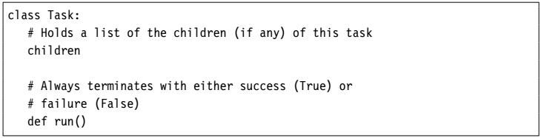
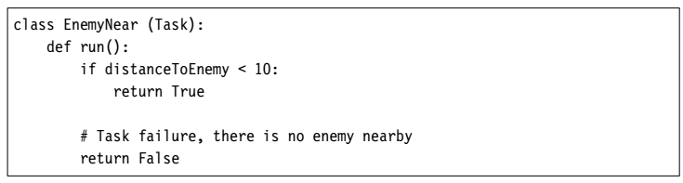
Task PsuedoCode

Slide 7
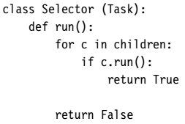
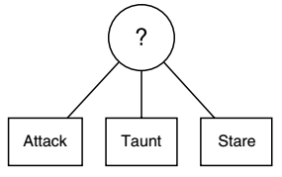
Types of Tasks
Composite Types
Selector
Will run through all of its children until it one of them returns a success or runs out of children.

Slide 8
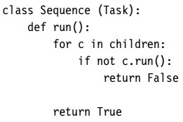
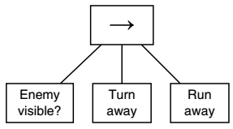
Types of Tasks
Composite Types
Sequence
Runs through all its children as long as each child returns a success.
On failure it exits out.

Slide 9
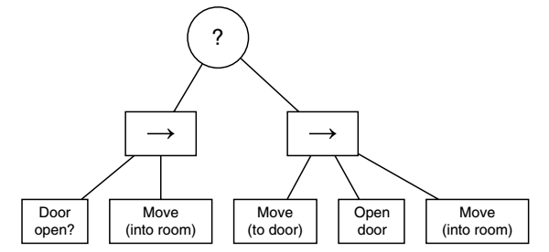
More Examples

Slide 10
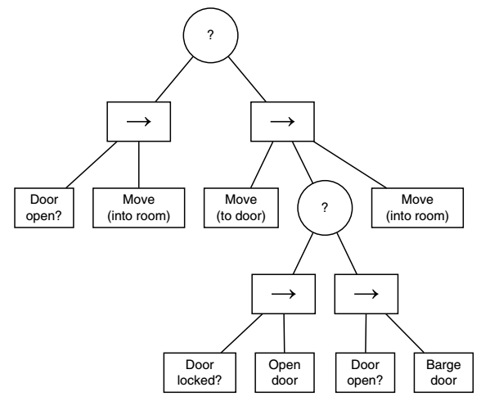
More Examples

Slide 11
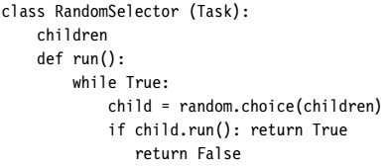
Other Composite Tasks
RandomSelector
Randomly chooses a child task to run then exits.

Slide 12
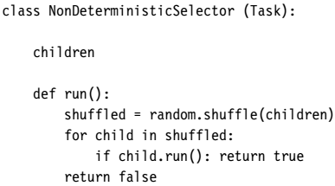
Other Composite Tasks
NonDeterministicSelector
Walk through the children in an random order.

Slide 13
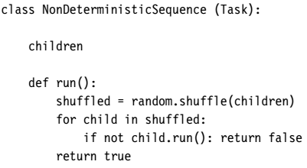
Other Composite Tasks
NonDeterministicSequence
Walk through the children in an random order.

Slide 14
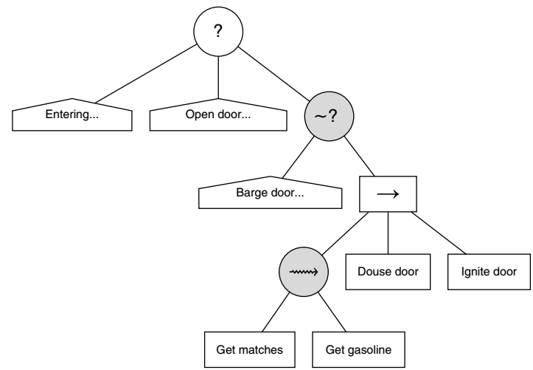
Other Composite Tasks
Example Behavior (Random)

Slide 15
Other Composite Tasks
Decorator
Another OO pattern, refers to a class that wraps another class, modifying its behavior.
If the decorator has the same interface as the class it wraps, the rest of the software doesn’t need to know if its dealing with the original or decorator.
In a BT, is a type of task that has one single child that modifies it some way.

Slide 16
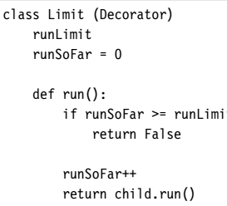
Decorator Example
Limit
Runs the task a limited number of times

Slide 17
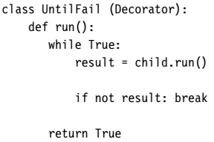
Decorator Example
UntilFail
Runs till fail

Slide 18
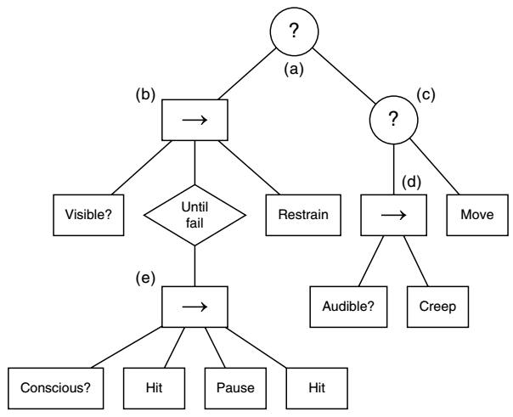
Behavior Tree Example

Slide 19
Decorator Example
UntilFail
Runs till fail

Slide 20
Data Problem
Lack of knowledge for each task.
We don’t want a bunch of different interfaces for tasks.
Coupling becomes a issue
Decouple data from behaviors
Create an external data store for all the tasks
Blackboard
Usually all behavior trees implement a blackboard in some fashion

Slide 21
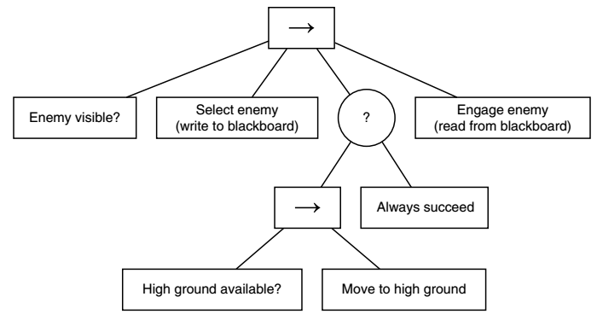
Blackboard

Slide 22
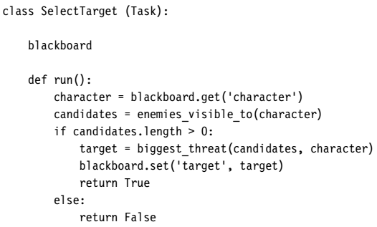
Blackboard

Slide 23
Blackboard
Some version of BTs will have blackboards for specific subtrees rather than for the whole tree.
You can have a hierarchy of blackboards
The blackboard will search its local data. If it fails it will search farther up the blackboard hierarchy

Slide 24

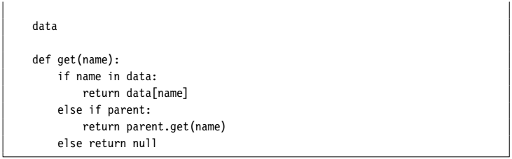
BlackBoard

Slide 25
Goal-Oriented Behavior
GAM 376

Slide 26
Goal-Oriented Behavior
Often called “planning”
planning is deciding what to do
that’s mostly what an AI system in a game does
Not path planning
we’re done talking about that
goal-oriented behavior is clearer, maybe

Slide 27
AI Planning
Planning has a long history in AI
Roots in “problem solving” systems
Classic example
(GPS, 1957)
3 missionaries and 3 cannibals
one boat can carry 2
but cannibals can’t outnumber missionaries

Slide 28
Strips Planning
Classic formulation of the planning problem (1971)
Starting point
situation described as a collection of states
End point
desired resulting world state
Operators
operations that can change the world state
pre-conditions
what must be true for the operator to work
post-conditions
how the world will be modified by the operator
Ad for CSC 380 here

Slide 29
Example
Operator
moves m missionaries and n cannibals from the right to the left bank
pre-condition
>= m missionaries on the right bank
>= n cannibals on the right bank
remaining missionaries on right bank not outnumbered by cannibals
not outnumbered in the new grouping on the left
post-condition
m fewer missionaries on the right
n fewer cannibals on the right
m more missionaries on the left
n more cannibals on the left

Slide 30
State space search
Usually we conceptualize this type of planning as search
Nodes
sets of world states
Edges
operators
What sequence of operators leads from current state to goal state?
Can be solved in the same ways
A* for example
heuristics can be hard to come by
very domain-specific

Slide 31
Typical approach
Backward chaining from the result
Start
we want a particular state of the world to be true
find an operator that would make it true
if we can apply this operator right now
we’re done
if not, it must be because some pre-condition isn’t satisfied
Recursively
try to generate a state of the world so that all the preconditions are true

Slide 32
Problems
Very slow on realistic problems
many operators
many, many legal states of the world
Plan first, act later
not practical in most applications
esp. games
Closed-world assumption
all relevant states known
true in games
but only if you’re cheating
not in real-world robotics
Always starts from scratch
previous planning effort wasted
doesn’t improve with practice

Slide 33
In games
Novel situations (should) never arise
constructing novel plans is not required
can reuse known plans
What we need is
arbitration between competing goals
decomposition of high-level goals
choice of known plan to employ
sequencing of plan steps
monitoring of plan execution
re-planning on failure
(getting better over time)

Slide 34
Behavior trees
Hierarchical planning
idea that a high-level might be satisfied many ways
Example
get to work
possible plans
take the el
take the Metra
car-pool with colleague
drive self

Slide 35
Decomposition
A plan is a series of steps
each of which is itself a goal
sub-goal of the original
Example
take the Metra
walk to train station (arrive before 8:50)
board train (have ticket)
get off train
get to CDM

Slide 36
Decomposition
Sub-goals may themselves require plans for their solution
Example
get to CDM from Metra
walk
cab
bus

Slide 37
Decomposition
Eventually we reach “atomic actions”
sub-goals that cannot be further decomposed
actions that the agent can just perform
get on bus
or is it step forward one pace?
However
we still need to monitor that the action is successful
may need to replan
Example
bus drivers on strike
change high-level plan to walk

Slide 38
Action planning framework
A few top level goals
related to game success
Raven
health
kills
weapons
Arbitration system
decides which goal at any given time
Plan library
set of pre-made plans for given goals
Sub-goal queuing and monitoring
maintaining a queue of subgoals

Slide 39
Goals
Methods
activate
calls when the goal is in operation
process
called as part of the update cycle
handle message
called whenever the agent gets notified
terminate
cleans up when the goal is complete
Composite goals
have associated subgoals
responsibilities
create and queue subgoals
forward messages to subgoals
reactivate if subgoals fail
terminate subgoals if terminated

Slide 40
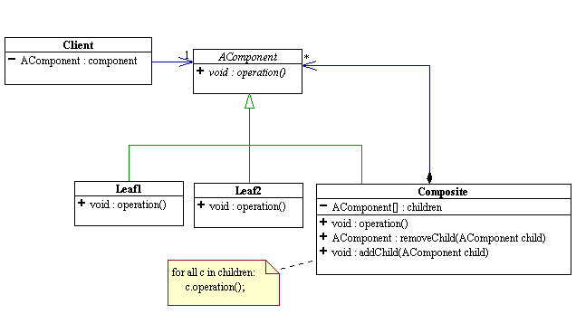
Composite pattern

Slide 41
A behavior tree
Goal_Think
Attack
Weapon
Explore
Health
if visible and there is dodging room
if not visible
if dodging not possible
Hunt Target
Dodge
Move Toward
recall last known position
Move to Position
if not in FOV
if in FOV
Follow Path
Seek to Position
until planning completes
...
Invoke Planner
Seek to Position
Traverse Edge
Traverse Edge

Slide 42
Note
Weapon handling and firing are autonomous
Don’t have to plan for this

Slide 43
Recovery
For TraverseEdge and SeekToPosition
Calculate expected arrival time
When this time is exceeded
mark goal as failed
Goal fails when subgoal fails
when goal fails
it is reactivated
causing replanning

Slide 44
Goal arbitration
High-level goals compete
should I attack or heal?
should I hunt weapons or enemies?
Special desirability functions
health = k x (1-Health)/DistToHealth
k must be tweaked empirically

Slide 45
FSMs as behavior trees
It is usually easy to implement FSMs as plans
FSM itself is a goal
States are plan steps
transitions
success or failure of step

Slide 46
Behavior trees as FSMs
In theory
you can always turn a behavior tree into a finite state machine
In practice
the size of the FSM can grow exponentially
not easy to create / maintain / debug

Slide 47
Example
Attack with flank
flank
move to the side and attack from angle
cover
stay back
use suppressing fire to pin target down
Attack with scout
scout
move forward under cover
report enemy position
flush out
stay back
use splash weapons like grenades

Slide 48
Advanced issues
Command queuing
subgoal structure can be used to issue commands
common in RTS games
Subgoal interference
what if subgoals repeated clobber each other
re-planning doesn’t help
blocks world example
the planner must notice that something is wrong
very hard to do
representation must be enhanced
so that a subgoal fails if it changes conditions established by sibling

Slide 49
Advanced issues
Prediction / Plan recognition
you can use a planning model to predict the player’s behavior
and then counter-plan
humans do this well
usually such things are scripted in games
Criticality
not all goals can be easily interrupted
a goal to jump over a gap
should remain active until it is completed
usually achieved by labeling goal as "critical"
and preventing overriding

Slide 50
Advanced issues
Animation planning
sometimes planning is used to generate low-level actions
corresponding to animation sequences
to achieve higher-level aims
like TraverseEdge
Examples
interacting with the world
doors
elevators
moving platforms
positional and footfall planning
planning agent positions
crouch, crawl, etc.
planning steps
necessary for animation
not important for high-level planning
usually

Slide 51
Learning
It is possible to get better over time?
see which plans work well in which circumstances
and which don’t
adjust planning
Yes, but

Slide 52
Learning
A lot of AI research has gone into such issues
case-based planning
reinforcement learning
But in games
great trepidation associated with adaptive algorithms
very hard to predict / debug
an adaptive AI may become too good

Slide 53
Active Objects
An alternative to planning
make the world model more informative
Associate messages with objects
“scents”
have those scents propagate through a level

Slide 54
Example
Need health
Health here

Slide 55
Active Objects
Objects’ messages
say what goal they can fulfill
“health here!”
“ammo here!”
Agents
can follow intensity gradient
towards goal
does not need an explicit plan

Slide 56
Sims
Sims characters have “drives”
eat
socialize
bathe
They look for opportunities to satisfy those drives
requires recognizing objects and using them
in the real world
require attending to messages related to that drive
in the Sims world
The characters look like they know what a phone is for
but really the phone knows what it is for
the characters just respond to its signal

